Slide 1
Accent Modification
November 16, 2018

Slide 2
TEAM MEMBERS
Naila Fatima (201530154)
Avani Agrawal (201530194)
Pooja Guhan (201530195)

Slide 3
Problem Statement:
Change the accent of a speaker to a desired accent and preserve the speaker’s voice identity by analysing the acoustic features and performing the modification wherever required.

Slide 4
Applications:
Integrating accent conversion to a text-to-speech system (TTS) can produce a voice with desired accent instantly and inexpensively.
Applying the technology to film industry can change an actor’s or actress’s accent to a desired accent without hard training for the actor or actress to learn a new accent.
It can be used as a foreign accent learning tool. It could allow the learners to listen to their own voice with the native speaker’s accent and to mimic that accent.

Slide 5
Understanding Accent (1)
Acoustic manifestations of differences in pronunciations and tone by a community of people from a national, regional or a socio-economic grouping
Difference between accent and dialect
Accent is the influence of the first language of a speaker to a second language while dialect of a given language are differences in vocabulary, grammar and speaking style of that language because of geographical and ethnic differences.

Slide 6
Understanding Accent (2)
Structural differences between accents can be divided into 2 broad parts:
Difference in phonetic transcriptions
Differences in acoustic correlates and intonation of sounds

Slide 7
Phonetics based differences between accents
Phonetic realizations of accent. - for the same phoneme, each accent group may have different phonetic realization rules.
Difference in the phonemic systems of accents: phonemic systems can be different in the number and or identity of the phonemes in the system.
Difference in the phonotactic distribution: accents may also differ in the environments in which particular phonemes do or do not occur.

Slide 8
Acoustic of Accents
Perceived acoustics differences of accents are due to the differences, during the production of sound, in the configurations, positioning, tension and movement of laryngeal and supralaryngeal articulatory parameters, namely vocal folds, vocal tract, tongue and lips
Acoustic aspects of accent that are used for acoustic models and accent synthesis:
Pitch prosody
Pitch trajectory at various linguistic contexts and positions. Eg: pitch rise at the beginning of a voiced group or phrase, pitch falls at the end of a phrase.
Pitch nucleus, i.e timing and magnitude of the prominent pitch event
Laryngeal (glottal) correlates of accent, i.e the voice of speech segments in certain contexts as a function of accent.
Formants
Duration

Slide 9
Prosody
Prosodic features are suprasegmental features which may reflect features concerning the speaker (such as the emotional state) or the utterance (such as the form of utterance and the presence of emphasis, contrast or sarcasm).
These are extracted from longer segments of speech such as syllables or words.
The prosodic features that we have used for accent modification are intonation, energy and duration. We have used these three as they cover different aspects of a speech signal- intonation deals with variations in pitch, duration deals with variations in the length of syllables or words spoken and energy deals with the energy present in the different syllables or words spoken.

Slide 10
Prosody Features taken into consideration:
Duration of each word in the sentence
Stress : Average energy (intensity) of each word
The average F0 (fundamental frequency syllable) contour for each word

Slide 11
Intonation
Intonation refers to the variations in pitch.
Pitch refers to the rate at which vocal folds vibrate. The value of pitch differs across individuals but the variations in pitch which are required to pronounce a certain syllable/word will be similar for all.
We have extracted the pitch contours for each word by using Wavesurfer.
The average fundamental frequency for each word is calculated and analysed.

Slide 12
Duration
Duration refers to the time required to utter the speech.
This helps us in accent modification as the duration of a spoken phoneme or word varies with the accent in which that unit is spoken. For example, the ‘o’ in ‘rock’ is stretched out more in a foreign accent when compared with speech in Indian accent.
We have extracted the duration features by dividing the utterance into words and then finding the length of each word for both the foreign and Indian speakers.
We modify the duration of each word in our signal to the duration of the same word in the reference signal. This has been done by using the phase vocoder.

Slide 13
Energy
This tells us the energy or intensity with which a particular syllable or word is spoken.
This helps us in accent modification as certain accents emphasize certain phonemes, thereby increasing the intensity with which that phoneme has been spoken. For example, the last ‘t’ in ‘that’ is more emphasized in a foreign accent as compared to an Indian accent.
We have extracted the energy by dividing the speech utterance into words and finding the energy of each words by taking the summation of square magnitude of each sample in the word.
Energy of word = Σs²(n)
where n is each sample in that word

Slide 14
Energy
We find the energy with which the reference speaker and the speaker whose accent is to be modified speak a particular word.
For a particular word, if the reference speaker has mean energy E₁ and the original speaker has mean energy E₂, we find the normalizing factor E₁/E₂ and multiply the signal for the original speaker with this normalizing factor.

Slide 15
Approach
We must have a speech utterance in the original accent of the speaker and the target accent and create transcriptions for both the signals.
Segment both the signals into words by using the transcriptions.
Find the prosody features (duration, energy and intonation) for each word in both the accents.
The prosody features in the original speech were changed according to the same in the accented speech. The duration of each word in the original speech is changed to that in the reference one, the energy of each word in the original speech is multiplied with a normalizing factor and the average pitch of each word in the original speech is scaled to that in the reference one.

Slide 16
Workflow
Parallel Speech Signal segments corresponding to each word
Duration modification
Energy modification
Pitch variation
Concatenate words to form sentences and obtain the modified speech signal

Slide 17
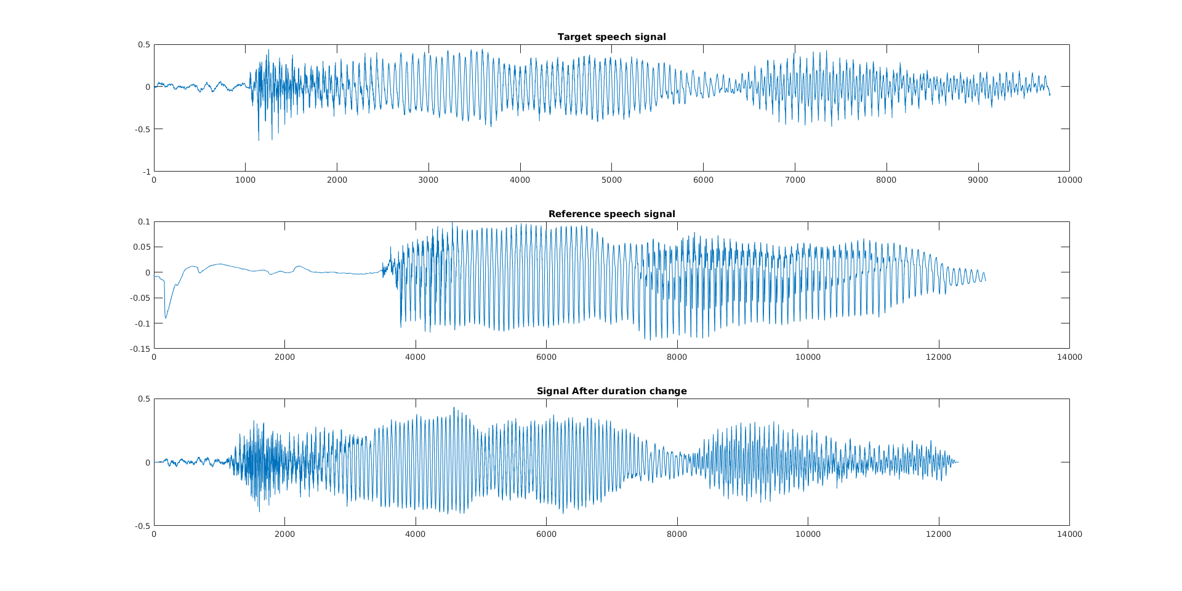
EXPERIMENTAL RESULTS (Indian to Foreign accent conversion - duration change)

Slide 18
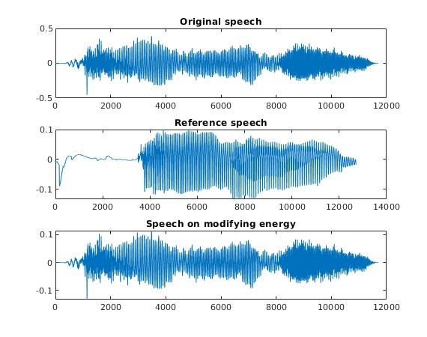
Energy modification (Indian to Foreign accent)

Slide 19
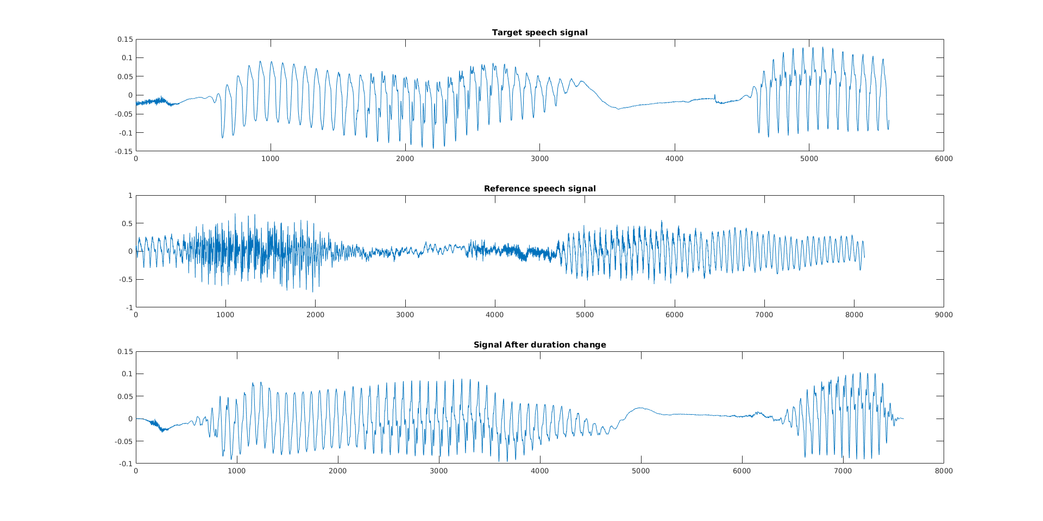
Result-2 (Foreign to Indian accent - Duration change)

Slide 20
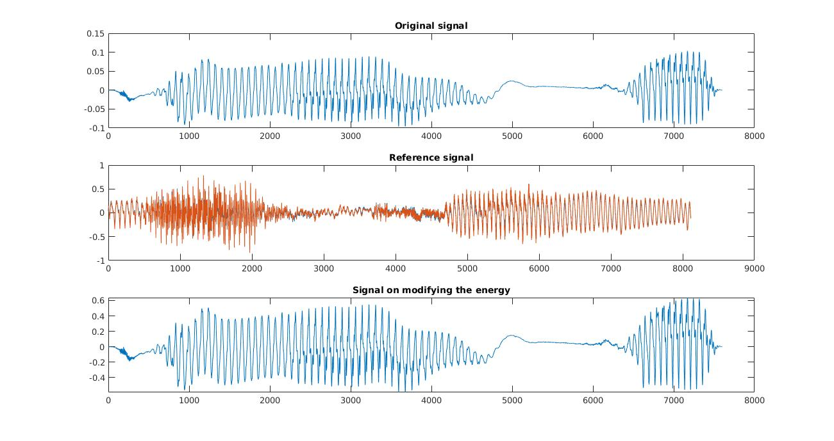
Energy modification (Foreign to Indian accent)

Slide 21
Challenges
In order to change the accent with which an utterance is spoken, we require a target speech which consists of the same utterance being spoken in the desired accent.
Since we are working with words, we require a transcription for each of the speech signals we use. This can lead to variations in the output signal as the transcriptions may be affected by coarticulation, thereby making it difficult to realize the actual duration of each speech unit.

Slide 22
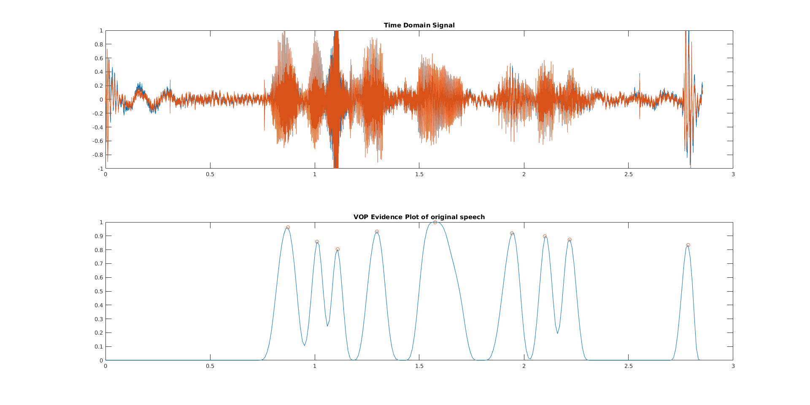

Slide 23
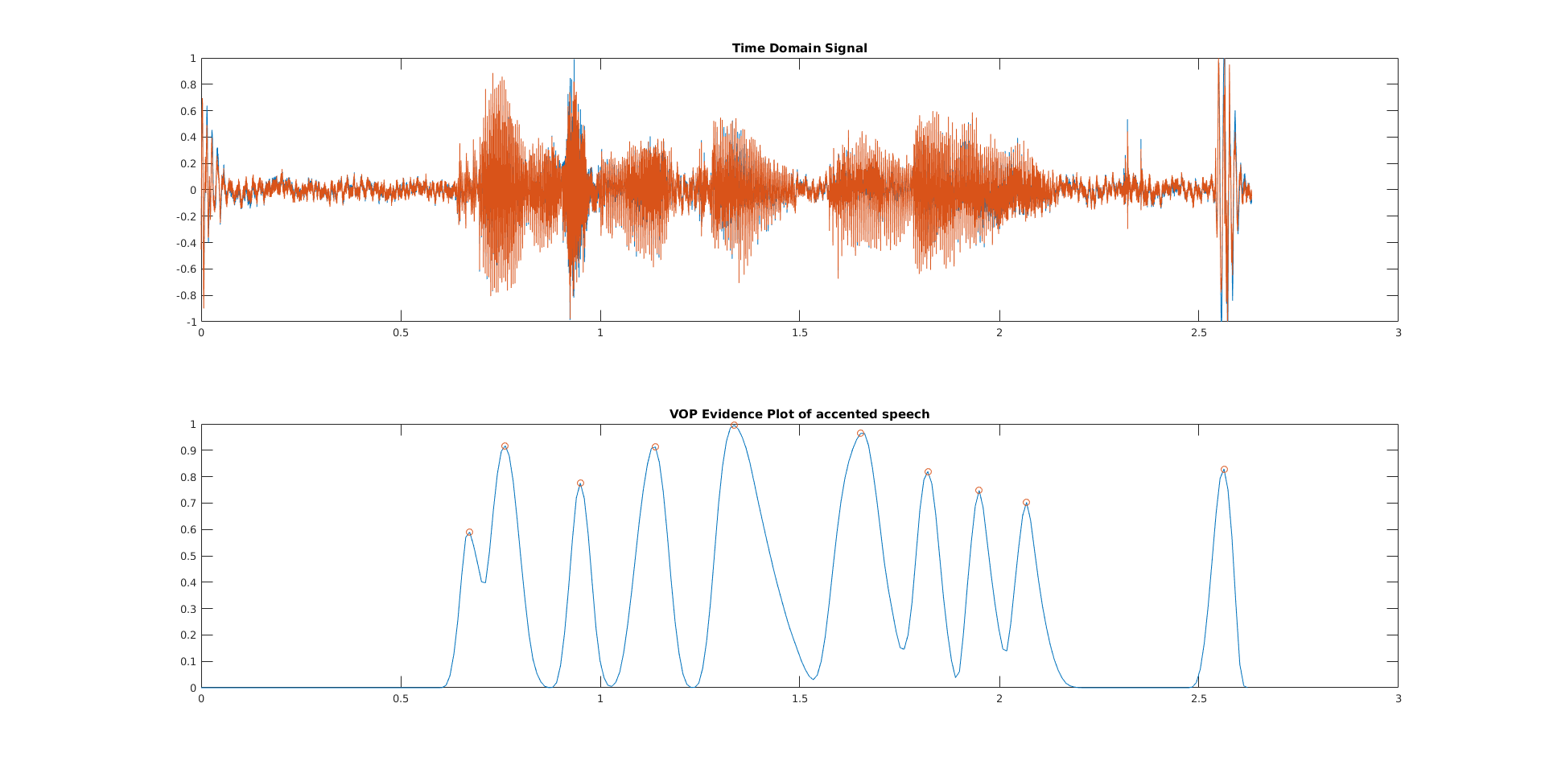

Slide 24
THANK YOU

